Slide 1

FOOD CONSUMPTION IN INDIA SANDRINE PREVOT
DAFT NOV21
FEB, 11th | PARIS

Slide 2
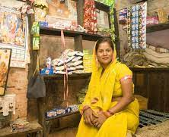
Business case
Domain: Consumer behaviour in India
Analyze the indicators that measure food expenditure for one month, taking into account their link with the social environment. It allows a better understanding of the consumer, the quality of life and the responsiveness of demand.
Keep in mind: there is a political issue: in a context of Hindu nationalism, the religion and casts is used for political purposes in order to divide Indians (the stigmatization is based food consumption)
The objective of the project is to see whether social characteristics determine consumption behavior or not.

Slide 3
Process
About data
Socio-Economic/Monitoring Survey of NSS
Title: India - Household Consumer Expenditure, NSS 68th Round : July 2011 - June 2012
(Expenditure for 1 month)
From : National Sample Survey Office - Ministry of Statistics and Programme Implementation(MOSPI),Government of India.
Data Loading
Data cleaning
EDA
Encode non-numeric data
Clusters Investigation
Model Evaluation
Model implementation

Slide 4
Data cleaning and preprocessing
1. Three datasets:
Household: Shape (101662, 45) + Shape (101662, 39)
Food expenditure: Shape (5763152, 35) with 183 food items
2. Build a unique dataset:
Merge on Household ID and features selections: Shape (100497, 33)
7 columns non-numeric – 26 columns numeric (1 ID, 9 on household and 23 on food)
3. Cleaning
Rename labels of columns
Build a new classification with filter on food items
Check for duplicates/ missing value
Exclude outliers in each numeric column
Drop rows with small numbers of household (ex: 'Zoroastrianism’, only one household)
Check collinearity

Slide 5
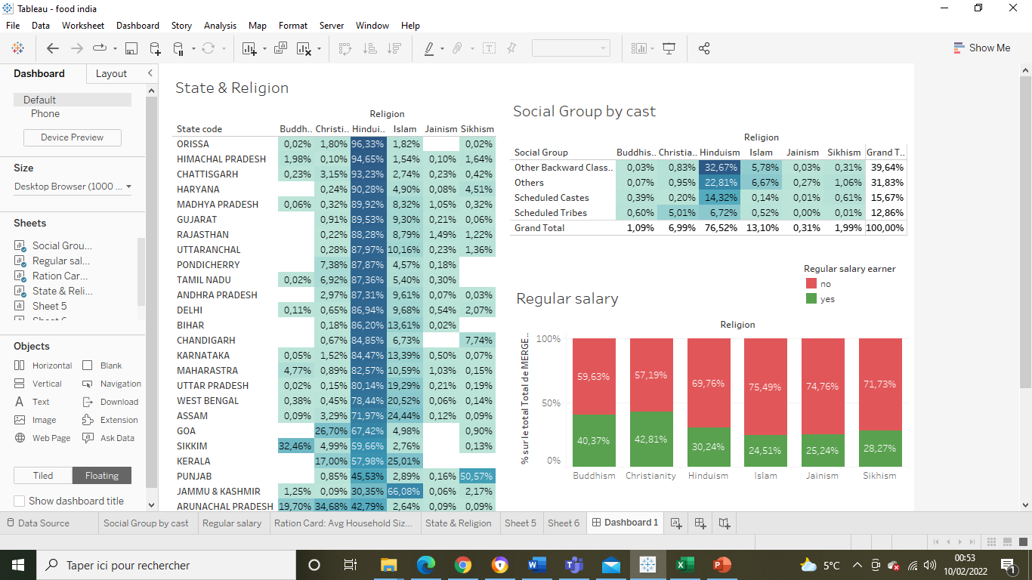
EDA
OBC
Scheduled Castes
Scheduled Tribes
➔ Communities in these administrative divisions benefit from the positive discrimination policy (Quotas in public employment and high School – 50% of places and jobs)
Others:
➔ Communities advanced socially and economically

Slide 6
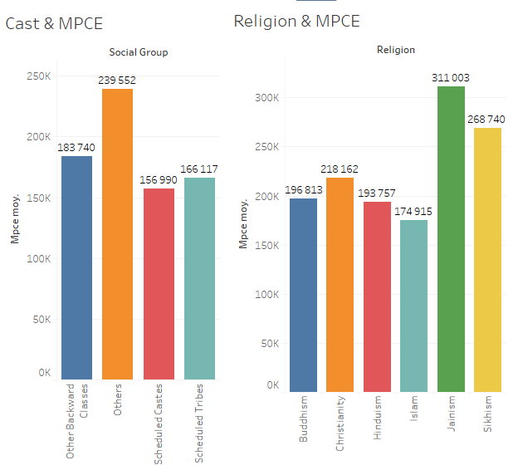
EDA
Monthly Per Capita Consumer Expenditure (MPCE)

Slide 7
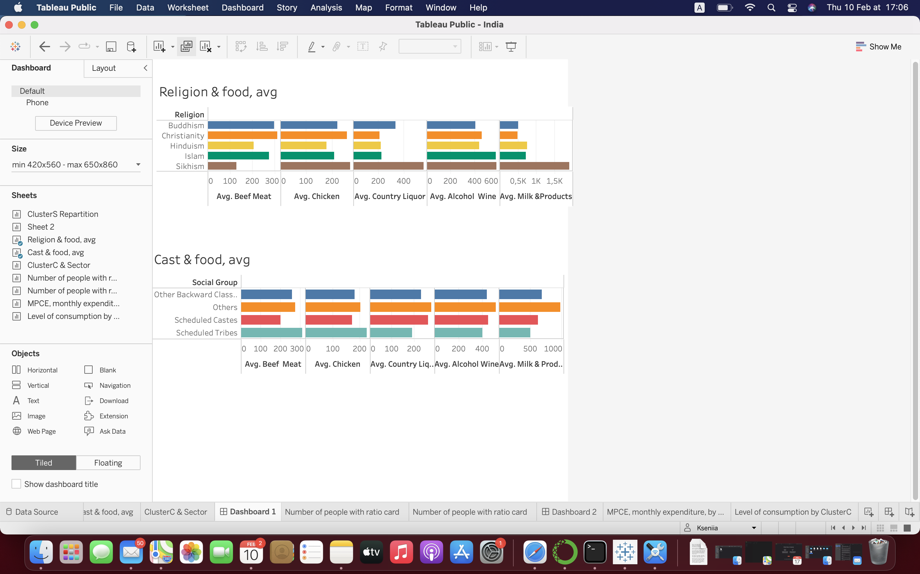
EDA

Slide 8
UNSUPERVIZED MODEL - KMEANS
24 columns to cluster
PCA:
Principal Component Analysis (PCA) is used for dimensionality reduction in machine learning.
PCA is used to filter noisy datasets, such as image compression.
KMEANS: Unsupervised machine learning algorithms
k-means clustering tries to group similar kinds of items in form of clusters. It finds the similarity between the items and groups them into the clusters.
K-means clustering algorithm works in three steps:
Select the k values.
Initialize the centroids.
Select the group and find the average

Slide 9
Models evaluation
Models | Optimum of clusters | Score Silhouette
KMEANS KElbowVisualizer(k = (2,5), metric='silhouette') | 2 | 0,623
AGGLOMERATIVE MODEL KElbowVisualizer( k = (2,5), metric='silhouette') | 2 | 0,561
GAUSSIAN MIXTURE (range (2,6)) | 2 | 0.620
DBSCAN MODEL (eps in range (1,5)&min_samples in range (2,5)) | 2 ( or 68) | -0.170 ( or -0.939)

Slide 10
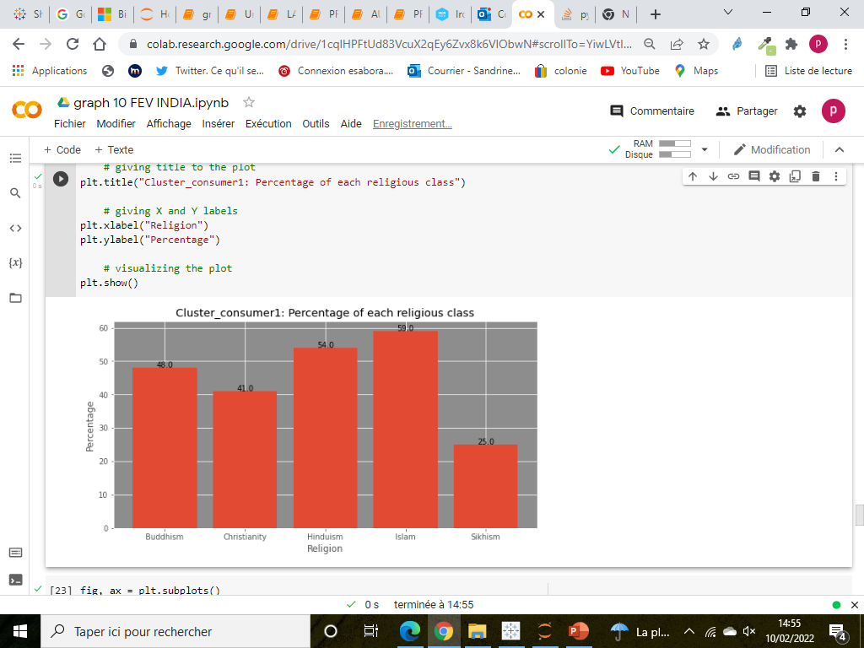
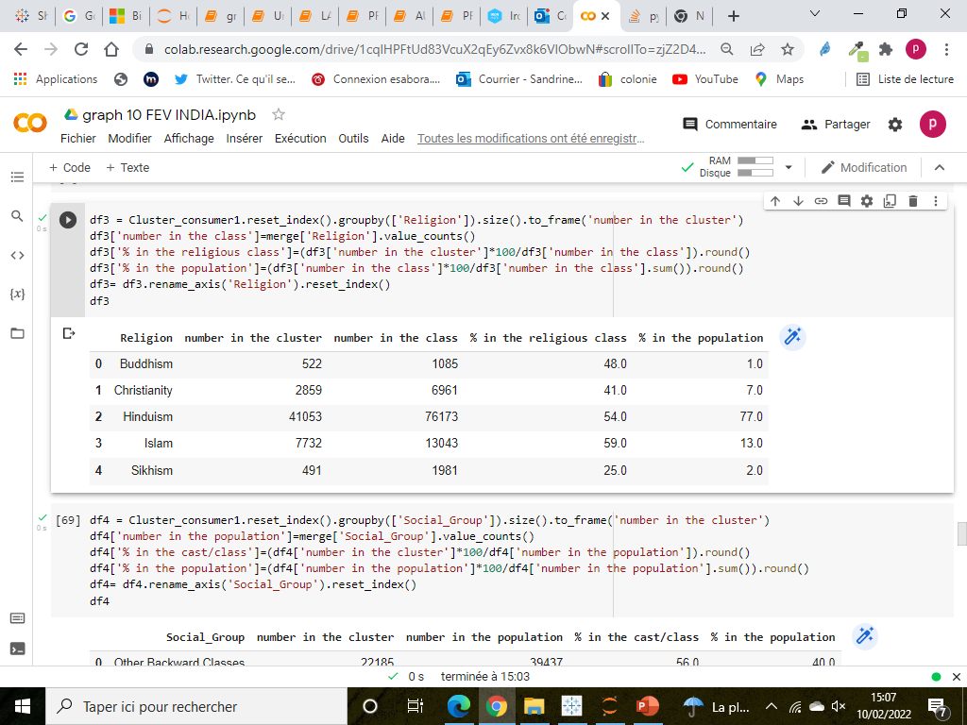
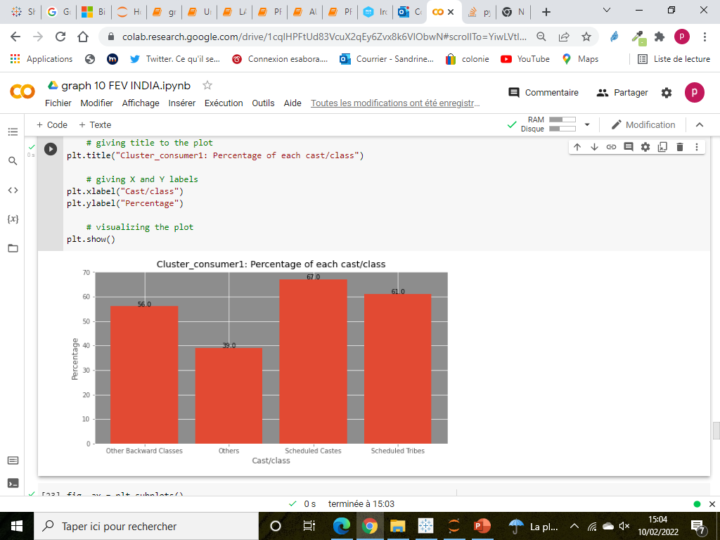
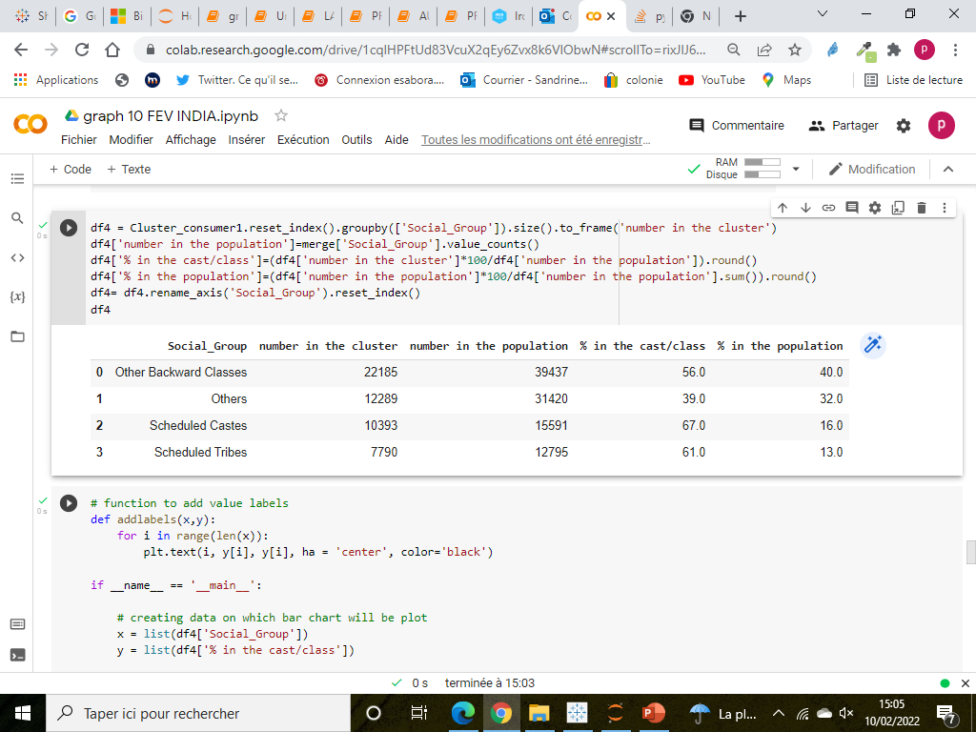
Main results
CLUSTER 1
Insights:
More Scheduled Castes & Tribes in cluster1 (67% and 61% respectively) (and Other mostly in cluster0)
More Muslims (59% of Muslims in cluster1)

Slide 11
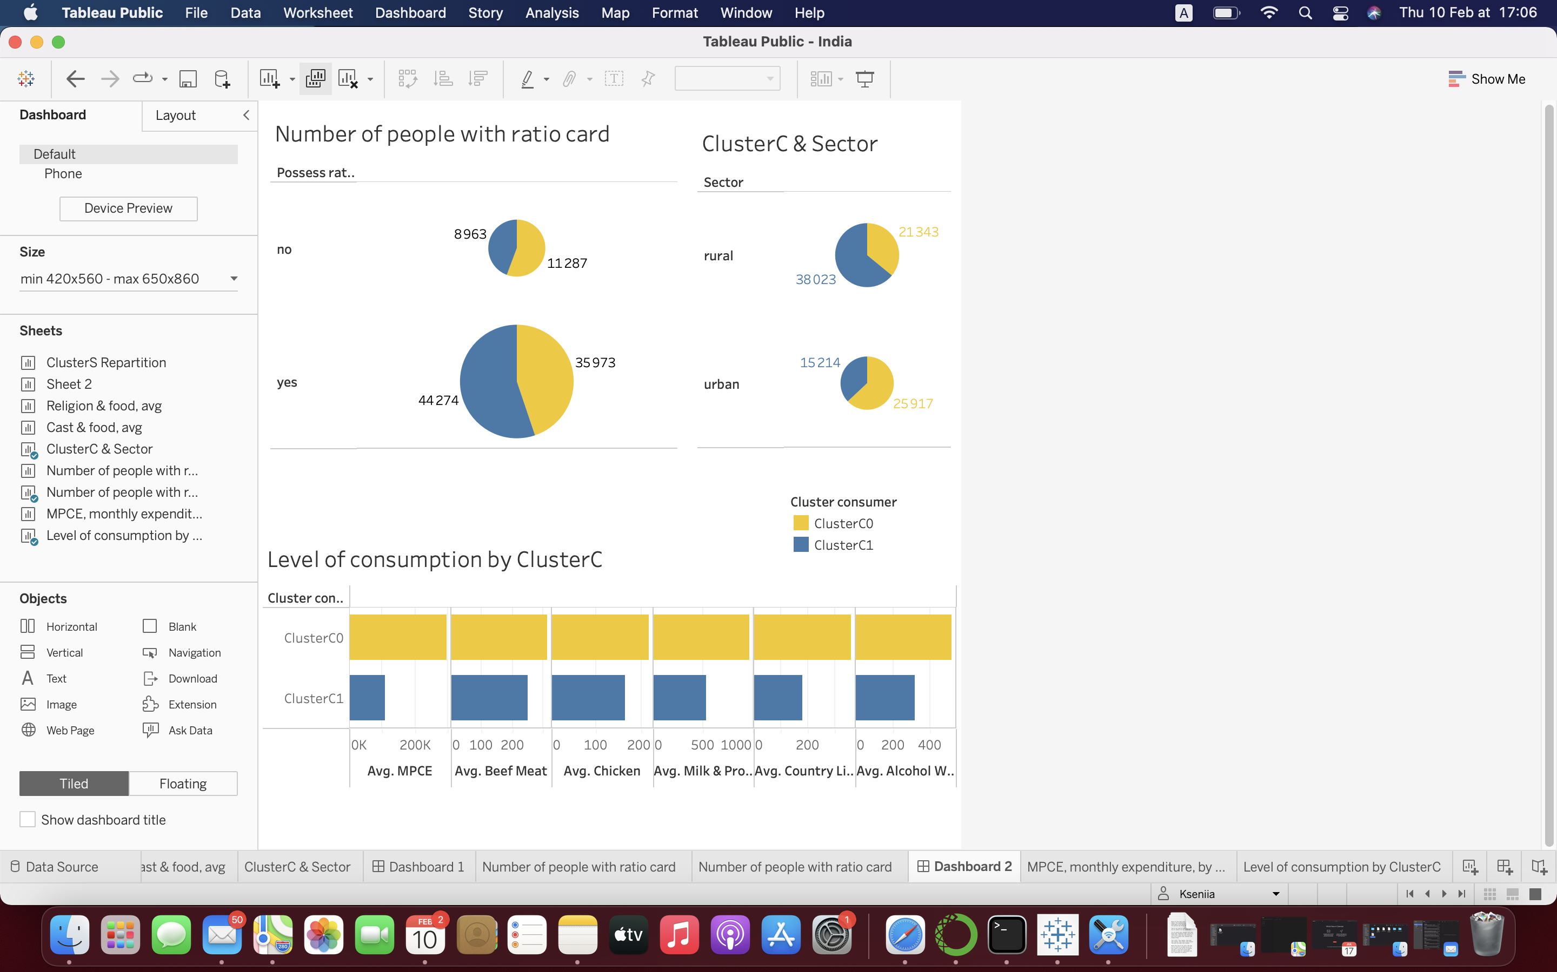
Main results
Cluster1: less money, less food,
more rural, with ration card

Slide 12
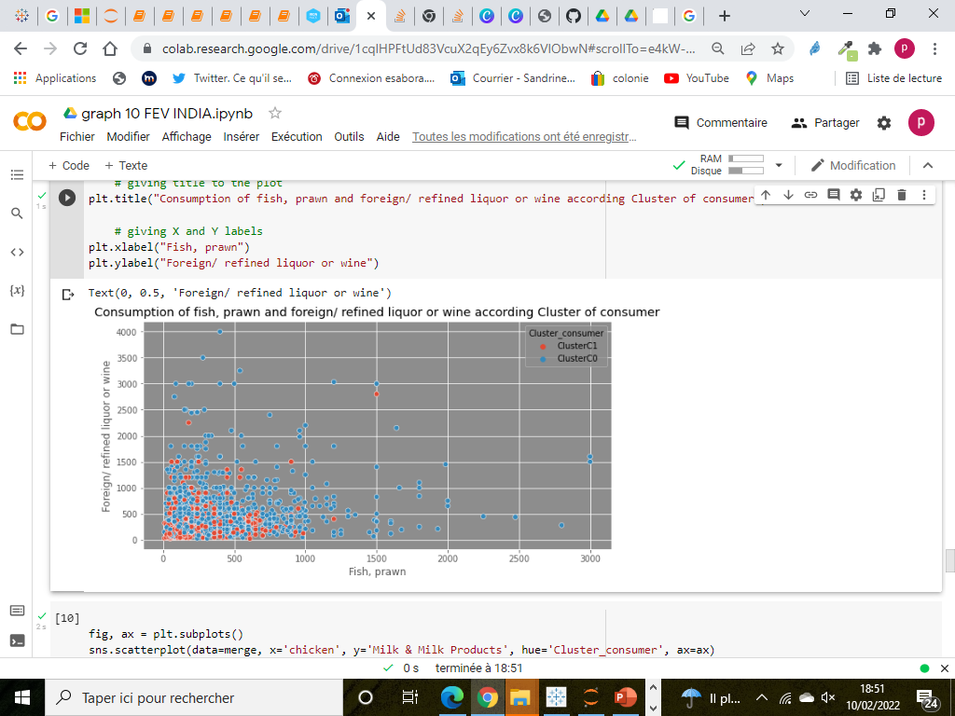
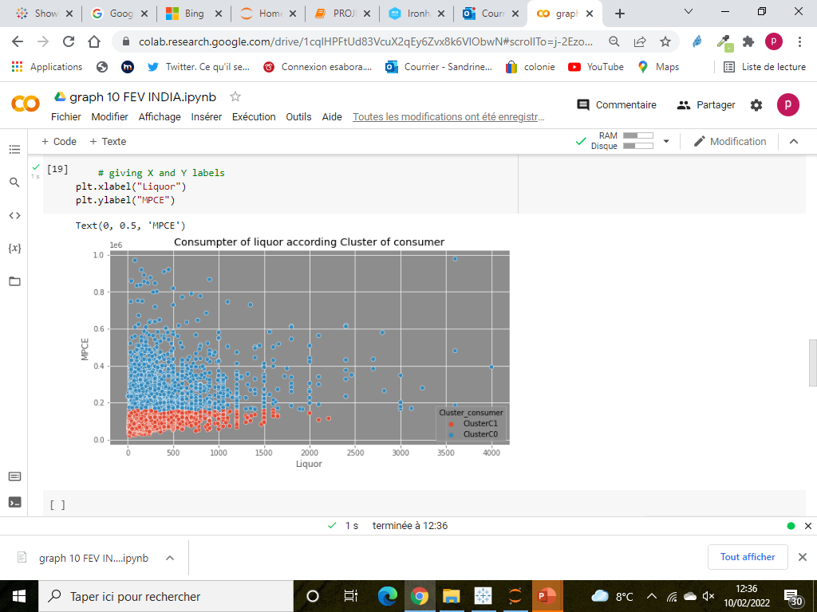
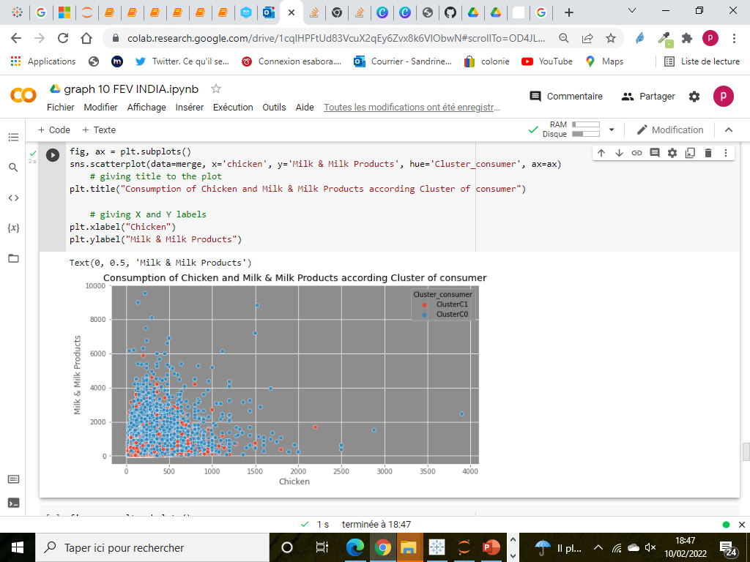
CONCLUSION
The main difference seems to be based on income level.
Religion and caste are not a criterion of food consumption –
you cannot assign special food to a religion/caste, regardless of income
But the poorest and those who eat less are mainly from the scheduled caste & tribes, have Islam as their religion and live in rural areas.
➔ There is no difference in the structure of food consumption linked to religion/caste values

Slide 13
FOOD CONSUMPTION IN INDIA
SANDRINE PREVOT
Q&A?

